Slide 1

Strategic Analytics Initiative Employee Development Program Utilization Analysis
Team 3G:
Dhvani Patel
Mishika Pankaj Bhandari
Haidong Yan
Shan Ali Shah Sayed
Junaid Ullah

Slide 2

Analysis Overview
Executive Summary
⁠Skill Level and Performance Trends Across Courses and Countries
Impact of Course Combinations and Sequences on Employee Proficiency Over Time
Comparison of In-Person vs Virtual training
Recommendations
Appendix

Slide 3
Executive Summary
The analysis covers several aspects of the training effectiveness in Skills and Competencies Development Program. Firstly, it identifies the courses with the highest to lowest percentage variations in course performance over time.
Secondly, the analysis show that employees who performed well and achieved over a 300% increase in their knowledge followed a highly effective course combination. Moreover, those employees also had an optimal sequences in which they took the courses which is a likely cause of their high performance.
Lastly, the analysis focus on evaluating the effectiveness of virtual versus in-person training formats for Advanced TMS, Logistics Software Essentials, and Intro to NERP. Key objectives which are included are identifying the most effective format for advanced learners, and highlighting areas for improvement in introductory courses like NERP.

Slide 4
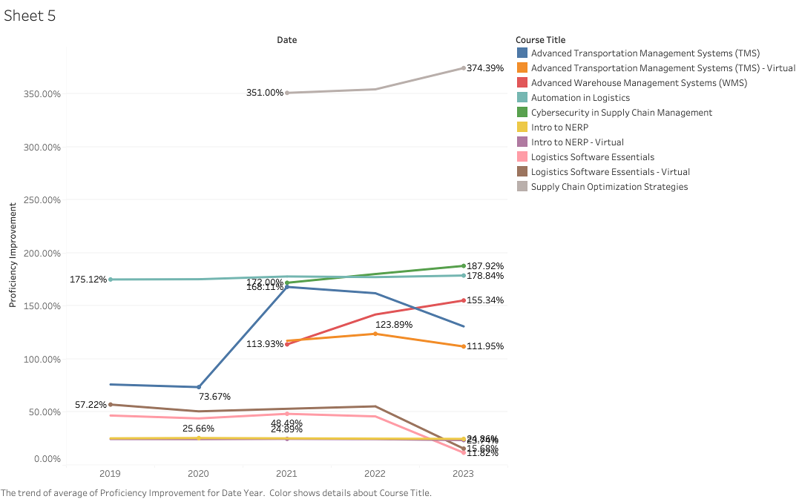
Proficiency Growth in Logistics Training: 374% Surge in Advanced Courses by 2023
Top Performer: Supply Chain Optimization Strategies showed the highest growth, with a 374.39% proficiency improvement by 2023, up from 351% in 2021.
Consistent Growth: Cybersecurity in Supply Chain Management steadily improved.
Advanced Courses Lead: Advanced Warehouse Management Systems showed a sharp increase to 155.34% in 2023, reflecting a strong upward trend.
Declining Trends: Some courses like Logistics Software Essentials - Virtual dropped sharply, ending at 11.82% in 2023.
Gap Between Virtual & In-Person: In-person versions of courses like Logistics Software Essentials saw significantly better outcomes than their virtual counterparts, showing a 24.84% proficiency gain versus 11.82% for virtual.
Inferences:
The data indicates a clear preference for advanced and specialized logistics courses, with significant proficiency improvements over time.
The decline in virtual courses' proficiency improvement could signal a potential issue with engagement or content delivery in the virtual format, which may require further investigation.

Slide 5
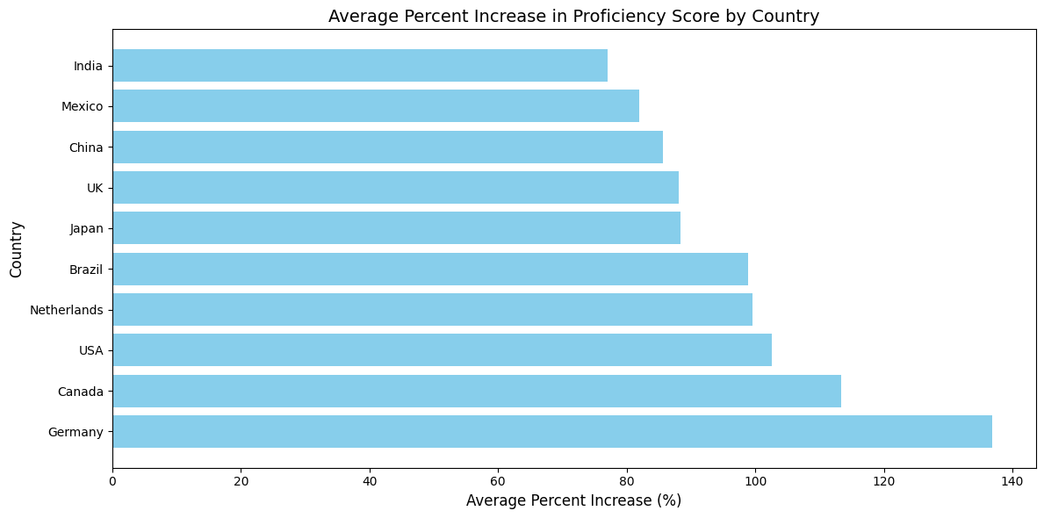
Average Percent Increase in Proficiency Score by Country
Top Performing Countries: Germany leads the list with an average percent increase of nearly 140%. This suggests that learners in Germany show the highest improvement in their proficiency scores after training compared to other countries. Canada follows closely with an average percent increase of just over 110%.
High-Increase Countries: USA and Netherlands also show significant improvement, both above 100%. These countries represent the next tier of strong performers in terms of proficiency score improvements.
Moderate Performers: Countries like Brazil, Japan & the UK are in the mid-range, with average percent increases around 80-90%.

Slide 6
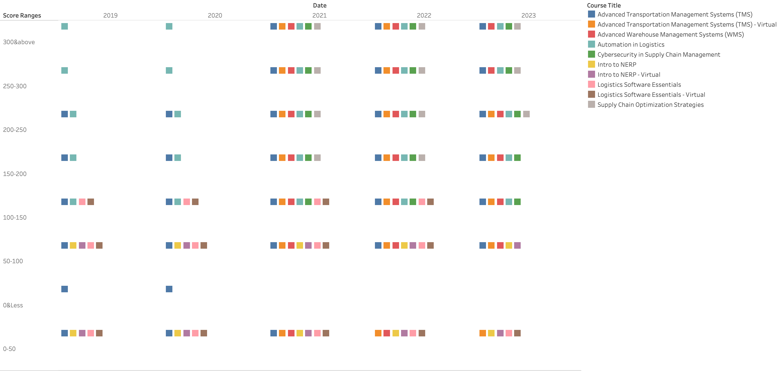
Courses taken in Specific Combinations Lead to Different Results in Employees Overall Proficiency
In 2023, the most prolific combination of courses which was taken by employees who showed an increase in their knowledge by over 300% was:
Advance Transportation Management Systems (TMS).
Advance Warehouse Management Systems (WMS).
Automation in Logistics, Cybersecurity in Supply Chain Management.
Supply Chain Optimization Strategies.

Slide 7
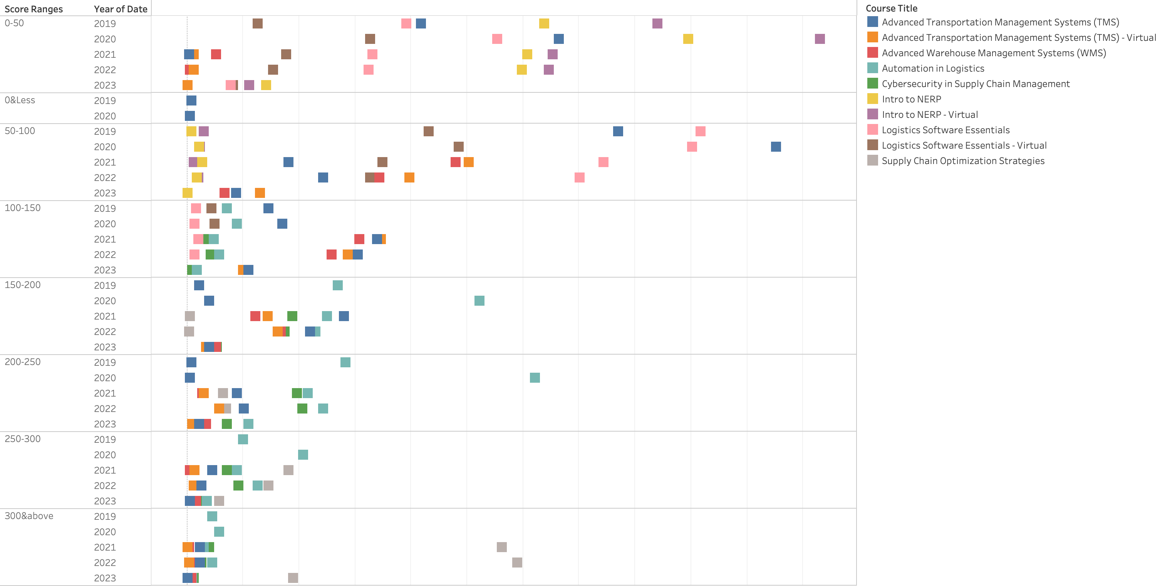
A Sequence of 3 Distinct Courses Results in Employees Overall Proficiency Scores of 300 and Above
The optimal sequence which led to employees showing the highest percentage increase of over 300 in 2023 was:
1. Advance Transportation Management System. (TMS)
2. Advance Warehouse Management Systems. (WMS)
3. Cybersecurity in Supply Chain Management.
4. Supply Chair Optimization Strategies.

Slide 8
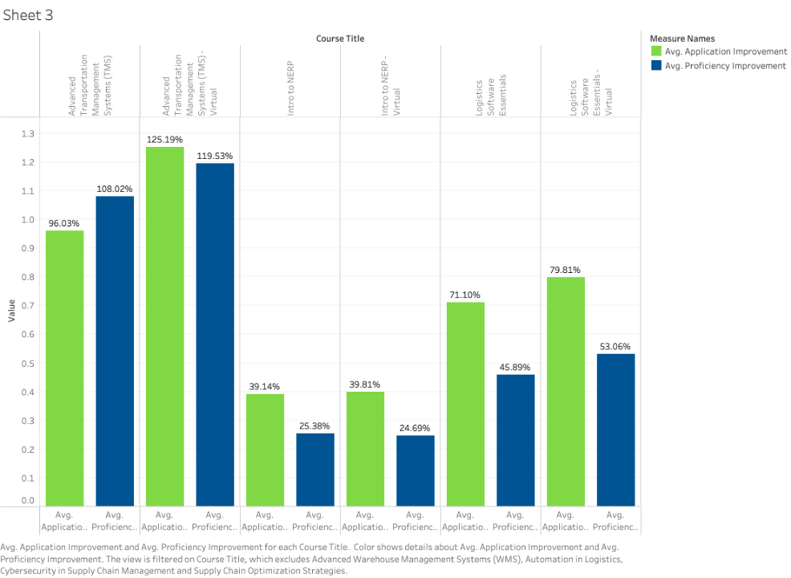
Comparing Virtual & In-Person training Across 3 Courses
125% Improvement in Application &
119% Improvement in Proficiency in TMS Virtual
Advanced Transportation Management Systems (TMS)
Virtual training shows the highest gains with 125% application improvement and 120% proficiency improvement.
In-person training still performs well, but lower than virtual, with 96% application and 108% proficiency improvement.
Intro to NERP
Both virtual and in-person formats have similar results, with ~40% application improvement and ~25% proficiency improvement.
Logistics Software Essentials
Virtual training excels in application improvement with 80%, while in-person lags slightly at 71%.
Proficiency improvements are more balanced: 53% for virtual and 46% for in-person.
Inference
This suggests that virtual training may be more effective for complex courses but not necessarily for all.

Slide 9
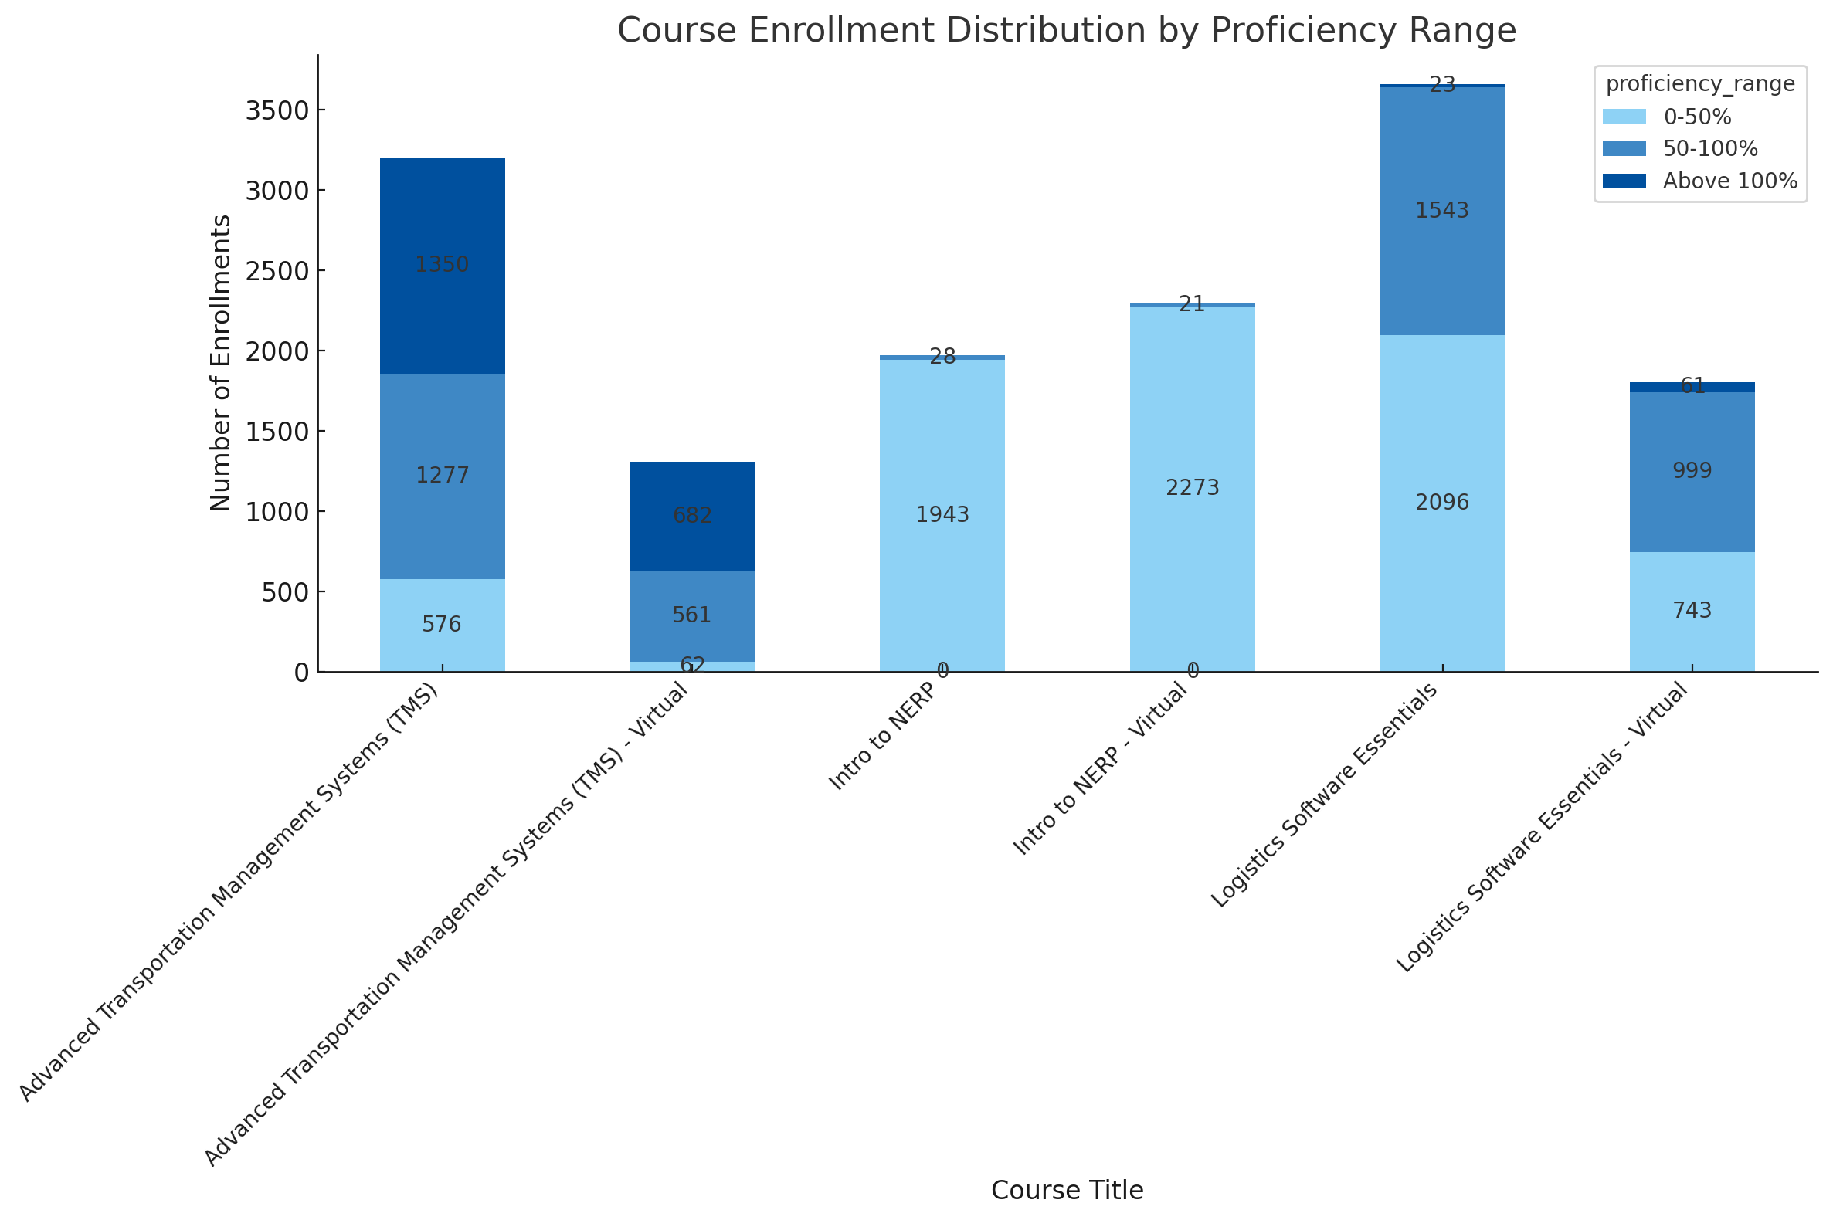
Over 9,500 Enrollments Show How Training Formats Influence Performance
Advanced Transportation Management Systems (TMS): In-person training has 3,203 enrollments with a balanced distribution across proficiency ranges, while virtual training has 1,305 enrollments, showing a high proportion of learners in the 50-100% range.
Intro to NERP: Both in-person and virtual formats show large enrollment numbers, with 1,943 in-person and 2,273 virtual enrollments, but virtually no learners surpassing the 100% proficiency mark.
Logistics Software Essentials: In-person training dominates with 3,662 enrollments, and nearly half fall into the 50-100% proficiency range. Virtual training has 1,803 enrollments, with more learners achieving proficiency beyond 100%.
Inference
In-person training formats generally have higher enrollments, especially in courses like Logistics Software Essentials.
However, virtual formats for some courses, such as Advanced TMS, show a substantial number of learners in the 50-100% proficiency range, indicating that virtual training can be just as effective for certain subjects.

Slide 10
Recommendations
Further Investigation: It may be useful to investigate into the courses showing the largest percent increases (like Supply Chain Optimization Strategies) to understand what is driving the improvements. Moreover, if courses are bundled in modules and given to employees in planned sequences, they can improve overall proficiency scores of employees.
Curriculum Evaluation: Courses like Logistics Software essentials, which show little change in percent improvement, could benefit from an evaluation of their content or instructional methods to see if improvements can be made.
Further Analysis: Investigate why countries like Germany and Canada perform so well. Understanding what drives such significant improvements in these countries can help apply similar strategies elsewhere.
Optimize Training for Low Performers: For countries like India, Mexico, and China, further analysis should be conducted to determine whether the training content, delivery method, or learner engagement could be improved to boost proficiency score increases.
Promote Balanced Training Formats: While in-person enrollments are higher, virtual formats deliver competitive results. A blended or expanded virtual offering could balance engagement across formats.

Slide 11
Appendix
Gen AI Usage:
ChatGPT was used to write python code for data merging and data cleaning.
Tableau & Python were used for data visualizations.
Excel was used for calculating the % increase in proficiency and application of employees.

Slide 12

Thank You!

